Slide 1
Unit-3: Nanosensors in agriculture
Nanoparticles, Nanoparticles based nanosensors for agriculture
Nanosensors in pesticide detection in soil
Nanobiosensors – basic principle and characteristics
Nanobiosensors for microbial detection in soil
Practice : Application of sensors for detection of humidity of soil, pesticide residue, nutrient requirement and crop pest identification

Slide 2
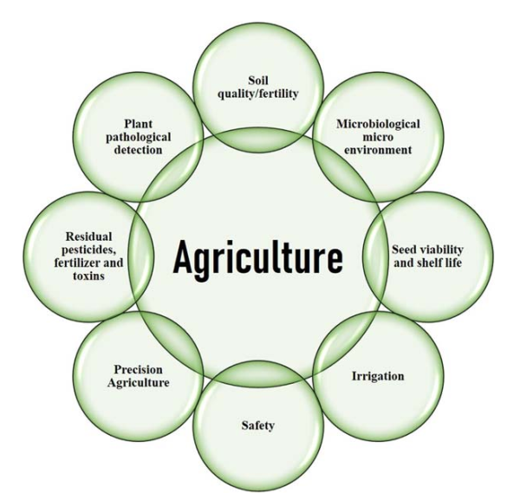

Slide 3
Nanoparticles
Ultrafine particles of matter
Size ranging between 1 and 100 nm
Catalysis, medicine, energy harvesting, agriculture, engineering, and environmental remediation

Slide 4
Nanoparticles
Organic nanoparticles
Inorganic nanoparticles
materials made up of elemental metal, metal oxides, or various metal salts
Carbon-based nanoparticles
high electronic conductivity, extraordinary chemical or electrochemical stability, large surface area

Slide 5
Nanosensors
Fabricated in the nanodimensions
Small size
less power for operation
high sensitivity
better specificity

Slide 6
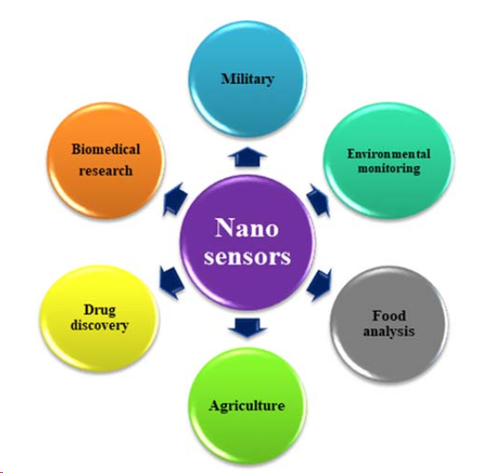
Applications of Nanosensors

Slide 7
Nanosensors and Food safety
Detecting and monitoring various contaminants
Pathogens
Other harmful substances in food products

Slide 8
Nanosensors and Food safety
designed to specifically bind to these contaminants, causing a change in their electrical, optical, or mechanical properties that can be detected and measured
functionalized with molecules that bind to specific pathogens
can detect changes in the chemical composition of food, such as the presence of volatile organic compounds, that indicate spoilage or contamination.

Slide 9
Components of Nanosensors
Design and Fabrication
design and fabricate the nanomaterials that will be used as the sensing element.
Functionalization
functionalized with molecules that can selectively bind to the target analyte
does not respond to other substances.
Assembly
functionalized nanomaterials are then assembled into the final nanosensor device.
Readout device
spectrometer, a microscope

Slide 10
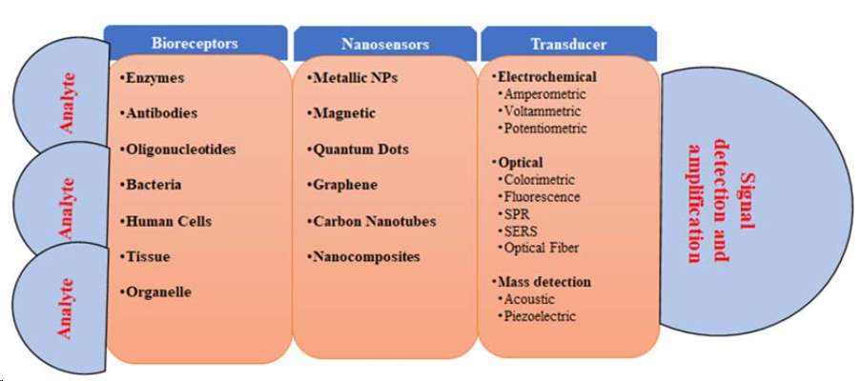
Components of Nanosensors

Slide 11
Components of Nanosensors
Glucose sensor for monitoring blood glucose levels in diabetic patients
nanomaterial, such as carbon nanotubes or gold nanoparticles
Functionalized - glucose-binding molecules, such as enzymes or antibodies
the glucose in the sample binds to the functionalized nanomaterials, causing a change in their electrical or optical properties
readout device, such as a glucose meter or a smartphone app

Slide 12
Nanoparticle-based sensors for agriculture
Quantum dots sensors
Carbon nanotube sensors
Copper nanoparticles
Zinc nanoparticles
Gold and silver nanoparticle sensors

Slide 13
Nanoparticle-based sensors for agriculture
Quantum dots sensors
Quantum dots in pesticide detection
Carbon quantum dots
Doped quantum dots
Silicon quantum dots
Quantum dots in herbicides detection
Cadmium telluride quantum dots
Molecular imprinted polymer coupled quantum dots
Soil moisture
Graphene-based quantum dots

Slide 14
Carbon nanotube sensors
Electrochemical acetylcholinesterase
Molecular imprinted polymer/carbon nanotube sensors
CNT nanocomposite sensors
Fullerene and quantum dot/carbon nanotube sensors

Slide 15
Nanoparticle-based sensors for agriculture
Copper nanoparticles
Pathogen detector
Pesticides detector
Zinc nanoparticles
Residual fertilizers
Pathogens
Soil moisture and humidity
Herbicides
Pesticides
Gold and silver nanoparticle sensors

